Slide 1
CAPSTONE PROJECT
Presented By
JIVITHA S
DEPARTMENT OF BIOTECHNOLOGY 3rd yr
ARUNAI ENGINEERING COLLEGE
3/21/2024 Annual Review

Slide 2
PROJECT TITLE
BITCOIN PRICE PREDICTION
3/21/2024 Annual Review

Slide 3


AGENDA
PROBLEM STATEMENT
PROJECT OVERVIEW
WHO ARE THE END USERS
YOUR SOLUTIONS AND ITS VALUE PROPOSITION
THE WOW IN YOUR SOLUTION
MODELLING
RESULTS
3/21/2024 Annual Review

Slide 4

PROBLEM STATEMENT
Bitcoin solved two critical problems that had plagued previous attempts at creating digital currencies:Centralization: Early digital currencies were controlled by a central authority, which introduced a single point of failure. Having centralized control created risks such as secret money creation, hacking, or government shutdowns. Bitcoin’s decentralized nature eliminates this central authority, making it resistant to manipulation.Double Spending: Ensuring that digital currency isn’t duplicated or double-spent was a challenge. Unlike sending digital photos, where copies don’t matter much, sending digital money requires certainty that a real transfer has occurred. Bitcoin’s blockchain technology solves this problem by providing a secure and transparent ledger that prevents double spending1.In summary, Bitcoin’s innovation lies in its ability to create a decentralized, tamper-proof digital currency that addresses these fundamental issues. 🚀
3/21/2024 Annual Review

Slide 5

PROPOSED SOLUTION
Certainly! Here are some proposed solutions for Bitcoin price prediction:Machine Learning Models:Researchers have explored various machine learning models for Bitcoin price prediction. These models include:Random Forest Regression: This algorithm uses an ensemble of decision trees to predict Bitcoin prices. It combines multiple decision trees to improve prediction accuracy1.Long Short-Term Memory (LSTM): LSTM, a type of recurrent neural network, has been used for Bitcoin price forecasting. It considers historical data and can capture long-term dependencies, making it suitable for time series prediction.
3/21/2024 Annual Review

Slide 6

SYSTEM DEVELOPMENT APPROACH
Certainly! Let’s explore the system development related to Bitcoin Coreand its developers:
Bitcoin Core is the most popular software client used by participants to create nodes, store coins, transact, and perform other operations on the Bitcoin network¹.
Bitcoin Core functions as an interface or gateway that determines how users interact with the Bitcoin blockchain. It is akin to how Google Chrome provides features for connecting to and navigating the internet¹.
The development of Bitcoin Core is a collaborative effort by a global team of developers who work tirelessly to build and maintain Bitcoin’s open-source network¹.
Unlike centralized projects, Bitcoin’s development is decentralized and consensus-based. There is no single individual or company that governs the development of the Bitcoin project. Instead, individuals or teams across the globe propose or initiate upgrades, which are subsequently peer-reviewed by hundreds of developers actively working on the Bitcoin project¹.
These developers ensure that the Bitcoin protocol is regularly maintained and upgraded. If an upgrade fails to attract enough support among network participants, its chances of implementation are very low¹.
3/21/2024 Annual Review

Slide 7

ALGORITHM AND DEPLOYMENT
Certainly! Let’s discuss algorithm development and deployment in the context of Bitcoin or any other software system:Algorithm Development:Algorithm development involves creating a set of instructions or rules to solve a specific problem or perform a task. In the context of Bitcoin or cryptocurrency, algorithm development can refer to various aspects:
3/21/2024 Annual Review

Slide 8
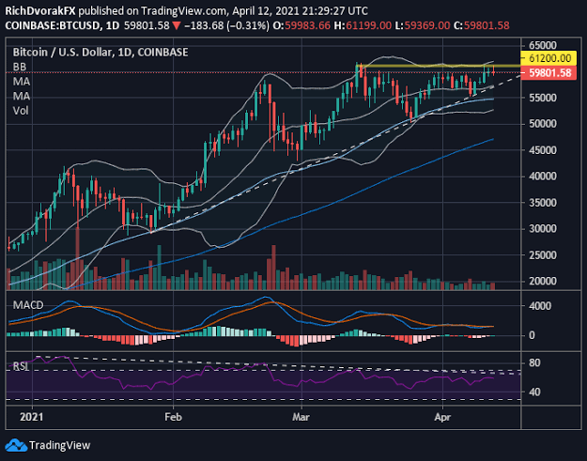
Modelling

Slide 9

Result
Long-Term Bitcoin Price Prediction:
Bitcoin’s price has been a topic of interest for investors, traders, and enthusiasts. While it’s essential to approach any prediction with caution, here’s a long-term outlook based on various analyses:
2024: The minimum predicted price for Bitcoin in 2024 is around $93,250.67, the average price is approximately $96,748.32, and the maximum could reach $110,180.98¹.
2025: Experts estimate that Bitcoin’s price in 2025 might have a minimum value of $135,356.46, an average of $139,227.08, and a maximum of $158,166.18¹.
2030: Looking further ahead, by 2030, Bitcoin could potentially reach a minimum price of $893,325.66, an average of $919,381.05, and a maximum of $1,122,762.71¹.
2040: Even in the longer term, predictions suggest that Bitcoin might continue to rise, with a projected range of $3,932,805.68(minimum) to $4,339,646.99(maximum) by 2040¹.
2050: By 2050, Bitcoin’s price could potentially reach a range of $5,126,208.33(minimum) to
3/21/2024 Annual Review
9

Slide 10
Conclusion
Bitcoin Core, the most widely used software client, is maintained by a decentralized team of dedicated developers. Their consensus-based approach ensures the network’s security and functionality
Demo Link
3/21/2024 Annual Review
10

Slide 11
Thank You

